Slide 1
EDR Features
Machine-learning based behavioral analytics for unknown and zero-day threats
Sophisticated response, investigation and forensics tools
Advanced threat intelligence and threat hunting
Next-gen antivirus, including malware, ransomware, exploits and fileless malware
Device control, protection and encryption

Slide 2
Top EDR / XDR
CrowdStrike
Microsoft
Palo Alto Networks
SentinelOne
Trend Micro
VMware Carbon Black
Cybereason
Cynet
Trellix (previously Fireeye & McAfee Enterprise)
Check Point
Sophos
Malwarebytes
Fortinet
Cisco
Broadcom Symantec
BlackBerry Cylance

Slide 3
Pricing
>15 USD per month
CrowdStrike
10~15 USD per month
Cybereason
Microsoft
3~10 USD
VMware Carbon Black (Minimum 100 endpoints)
Palo Alto Networks (Minimum 200 endpoints)
Malwarebytes
Trend Micro
Sophos
Kaspersky
Check Point ($3)
Trellix (previously Fireeye & McAfee Enterprise)
Fortinet
SentinelOne

Slide 4
Consideration
Threat detection performance (MITRE ATT&CK evaluations)
Strategy (product vision & feature enrichment) ( Gartner / Forrester Wave)
Pricing
Incident Response (Managed / Internal)
Support level
Management panel (SaaS / Hybrid /On-premises)
Threat Modeling / Compliance requirement (Audit / On-premises)

Slide 5
Other factors
Integrate with another security product? (Email, NGFW, NDR, SIEM)
Internet connection?
Concern about SaaS only portal?
Pricing and licensing model?
OS and platform type
Configuration (Ease of use and deployment vs Fine-grained control)

Slide 6
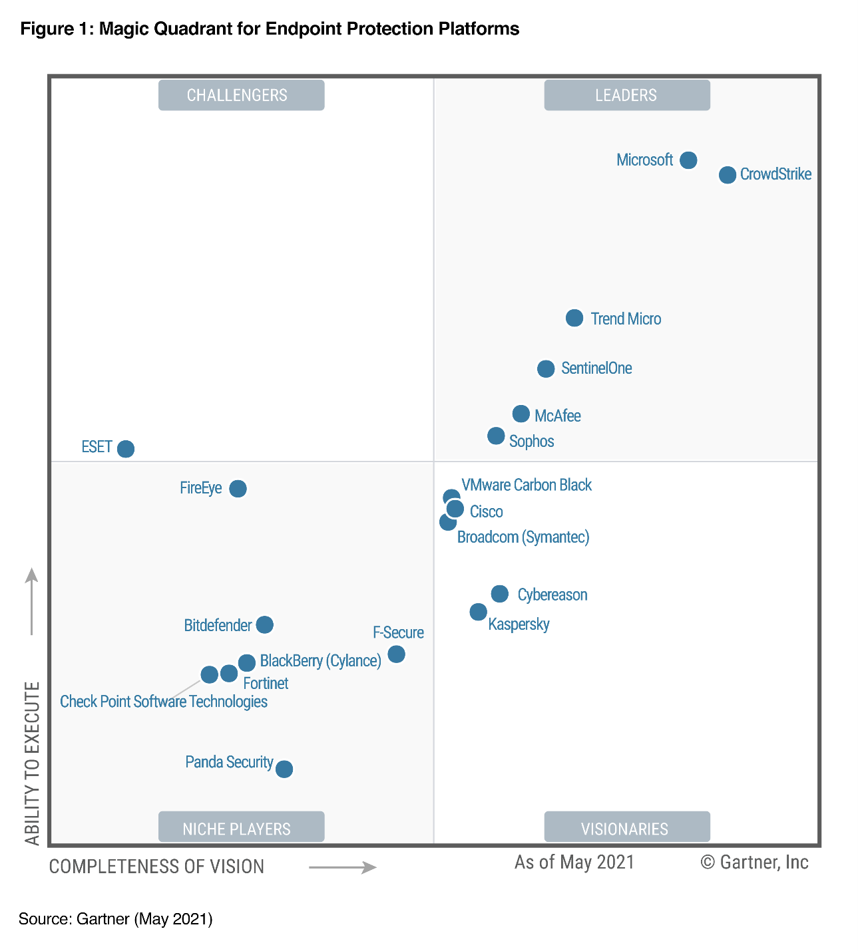
Gartner’s 2021 Endpoint Protection Platforms Magic Quadrant

Slide 7
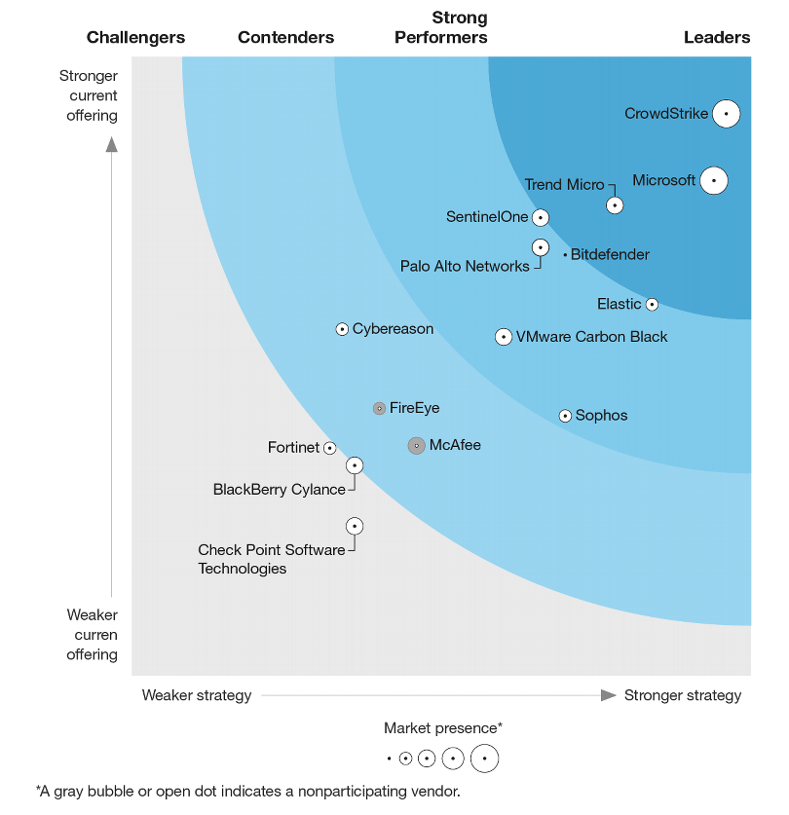
THE FORRESTER WAVE™: ENDPOINT DETECTION AND RESPONSE PROVIDERS, Q2 2022

Slide 8
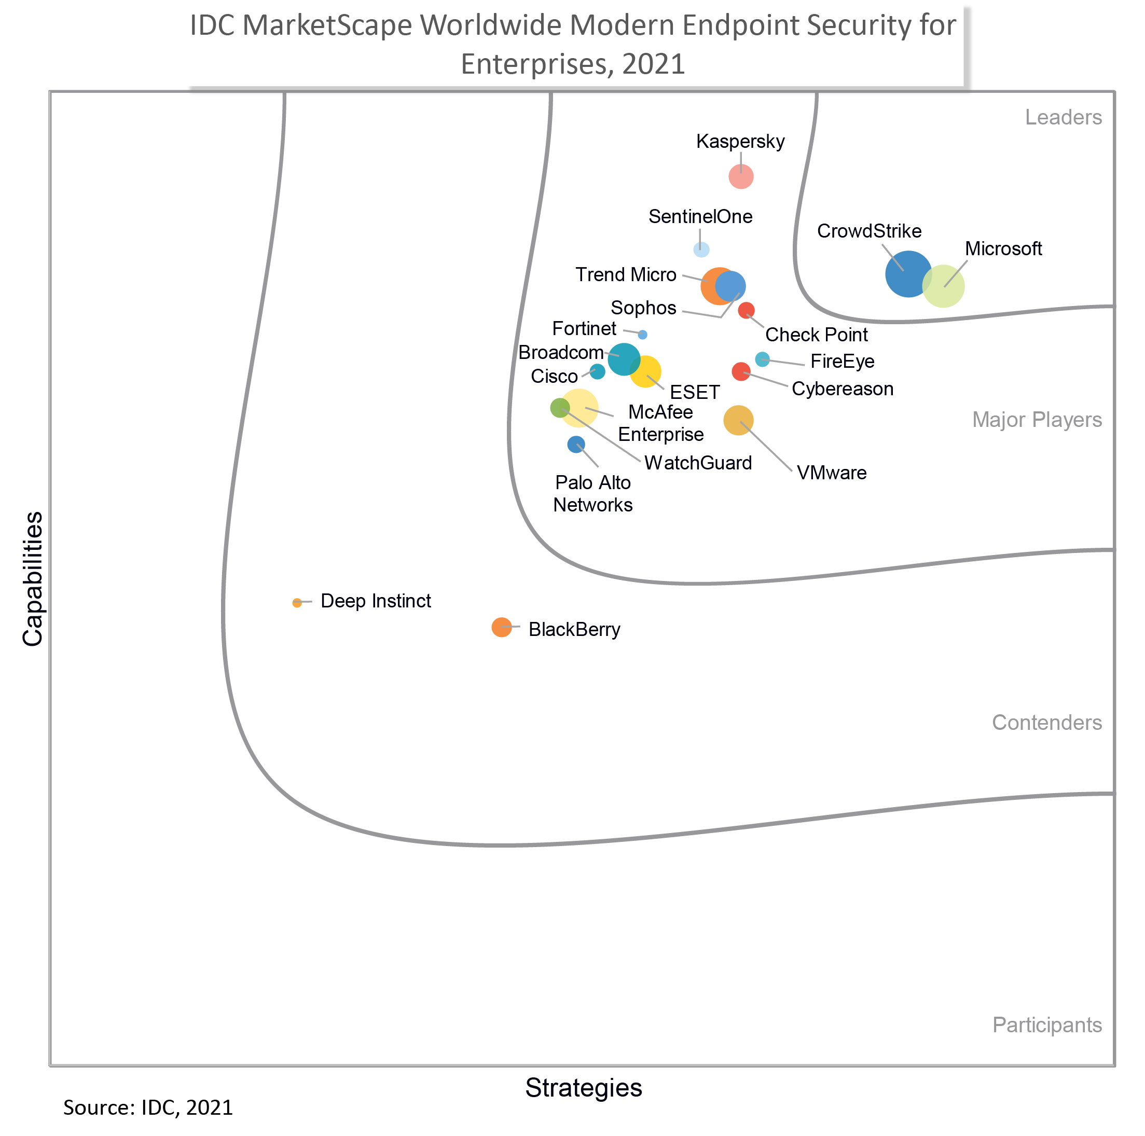
IDC MarketScape: Worldwide Modern Endpoint Security for Enterprise 2021 Vendor Assessment

Slide 9
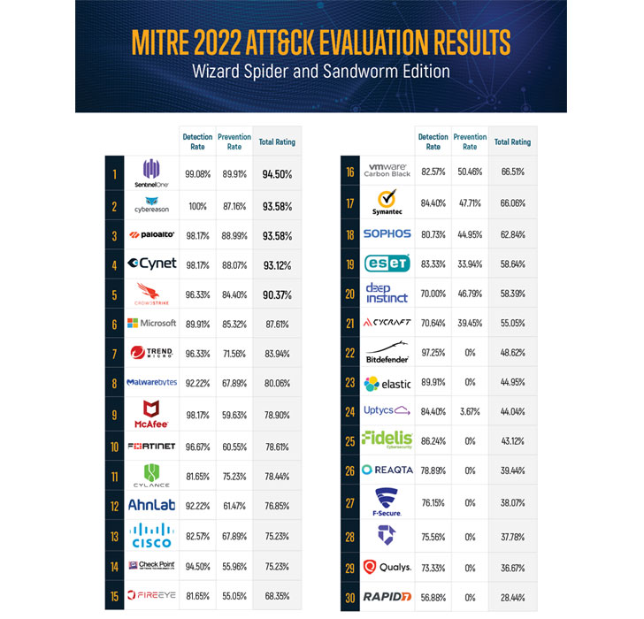

Slide 10
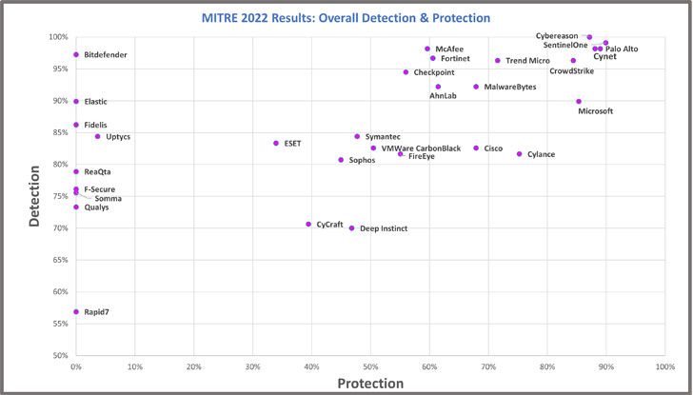

Slide 11
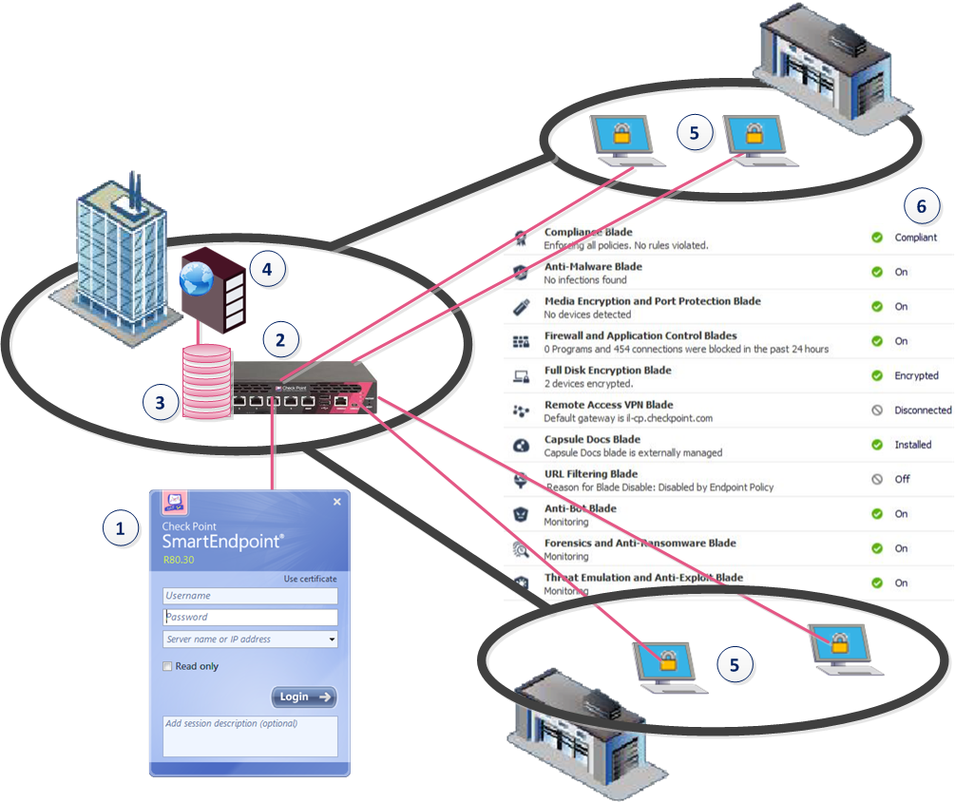
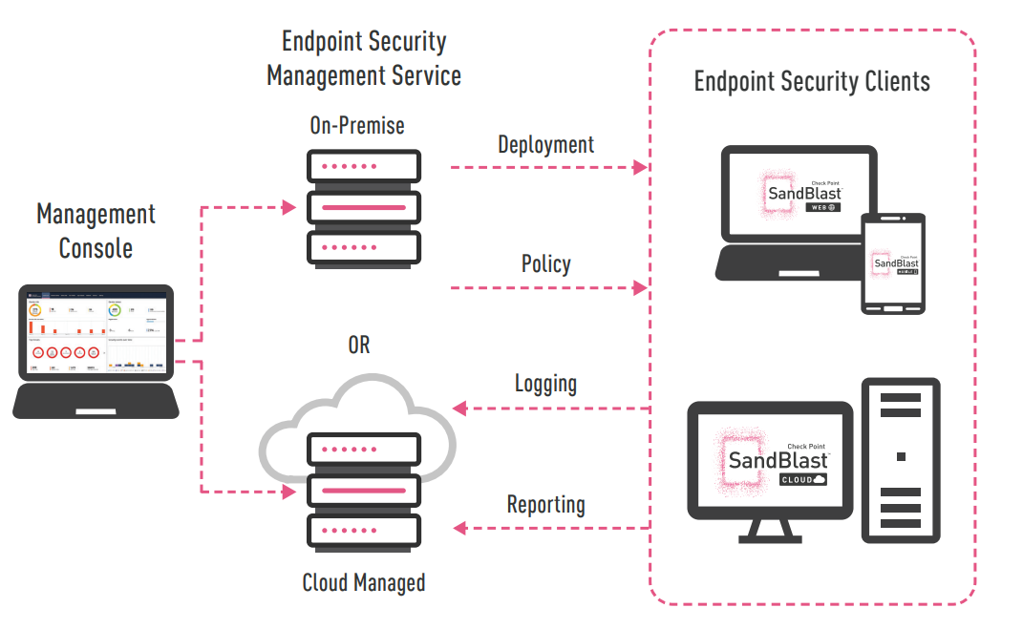
Check Point Harmony Endpoint

Slide 12
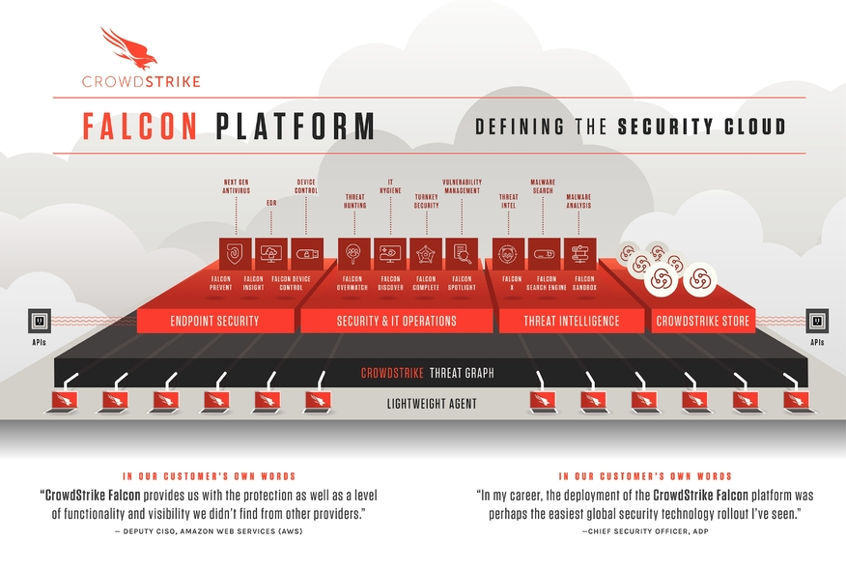
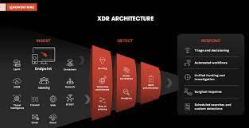
CrowdStrike Falcon XDR

Slide 13
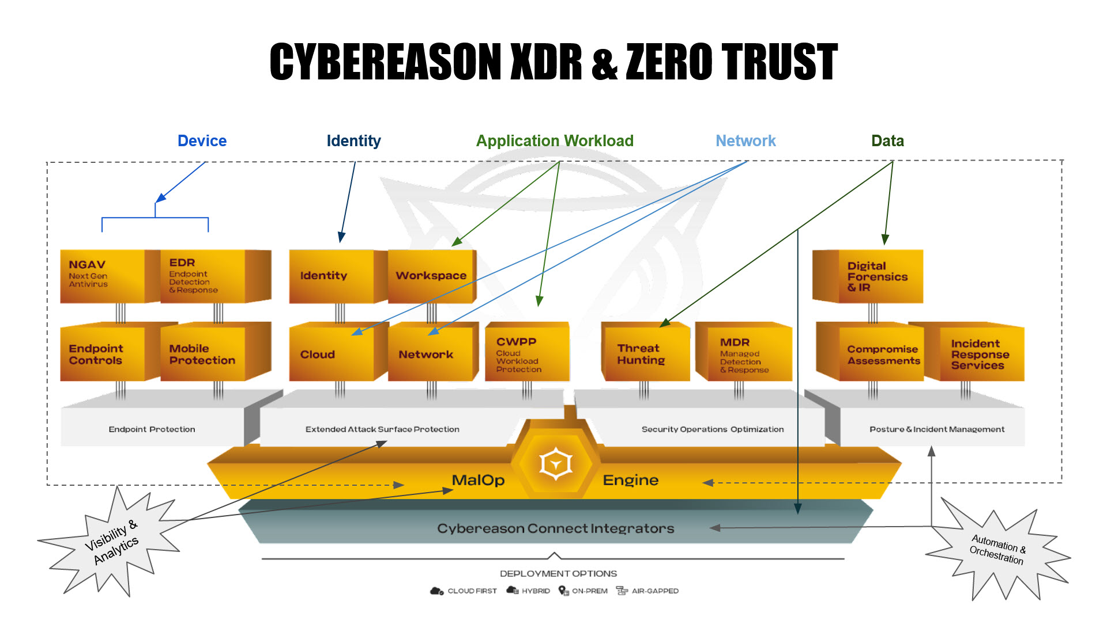
Cybereason EDR / XDR

Slide 14
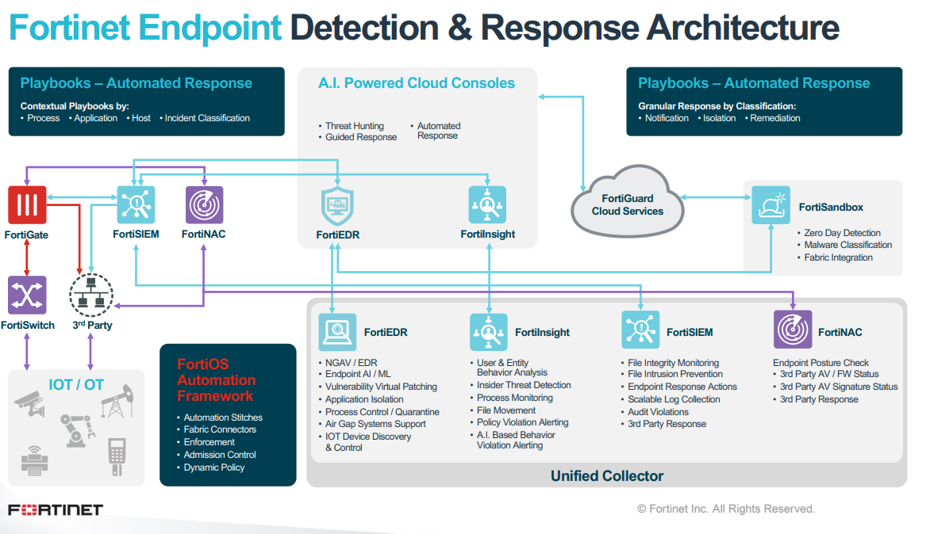
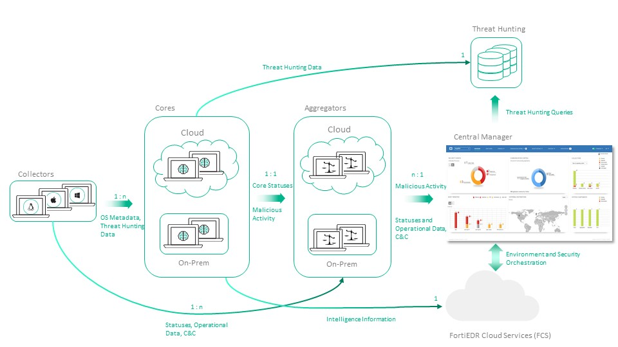
Fortinet FortiEDR

Slide 15
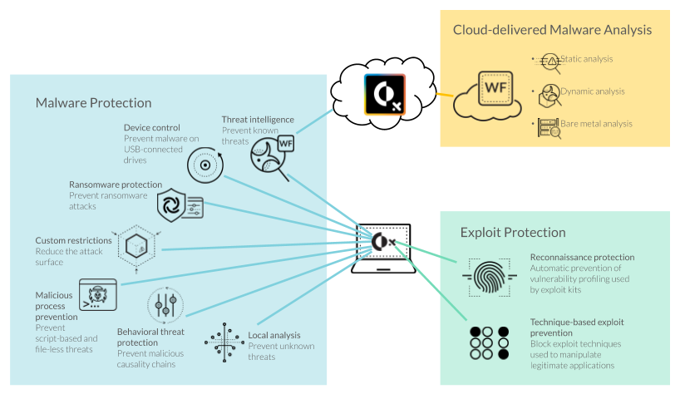
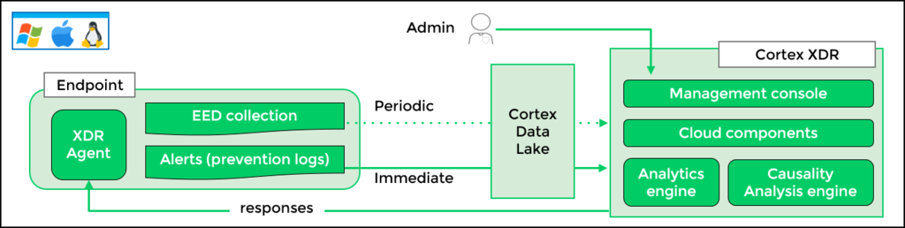
Palo Alto Networks Cortex XDR

Slide 16
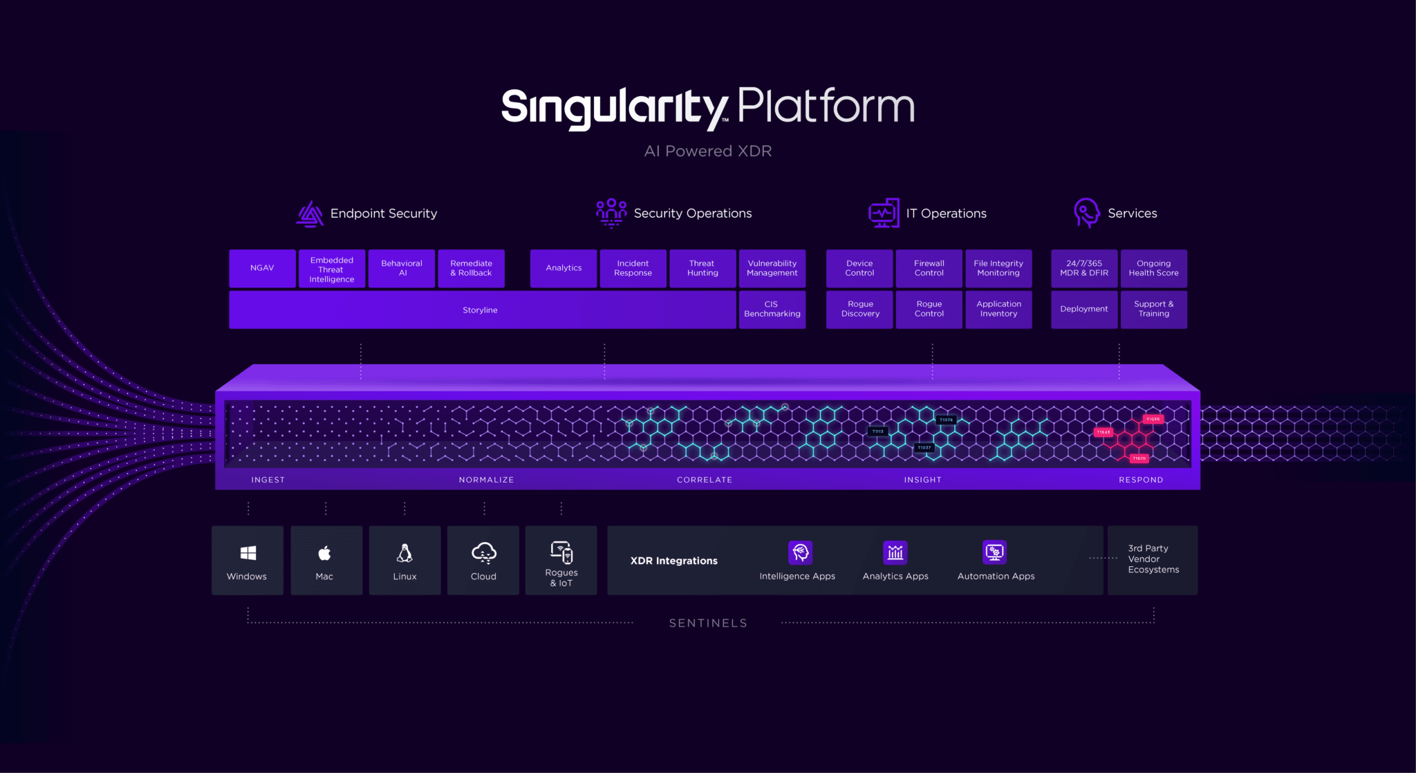
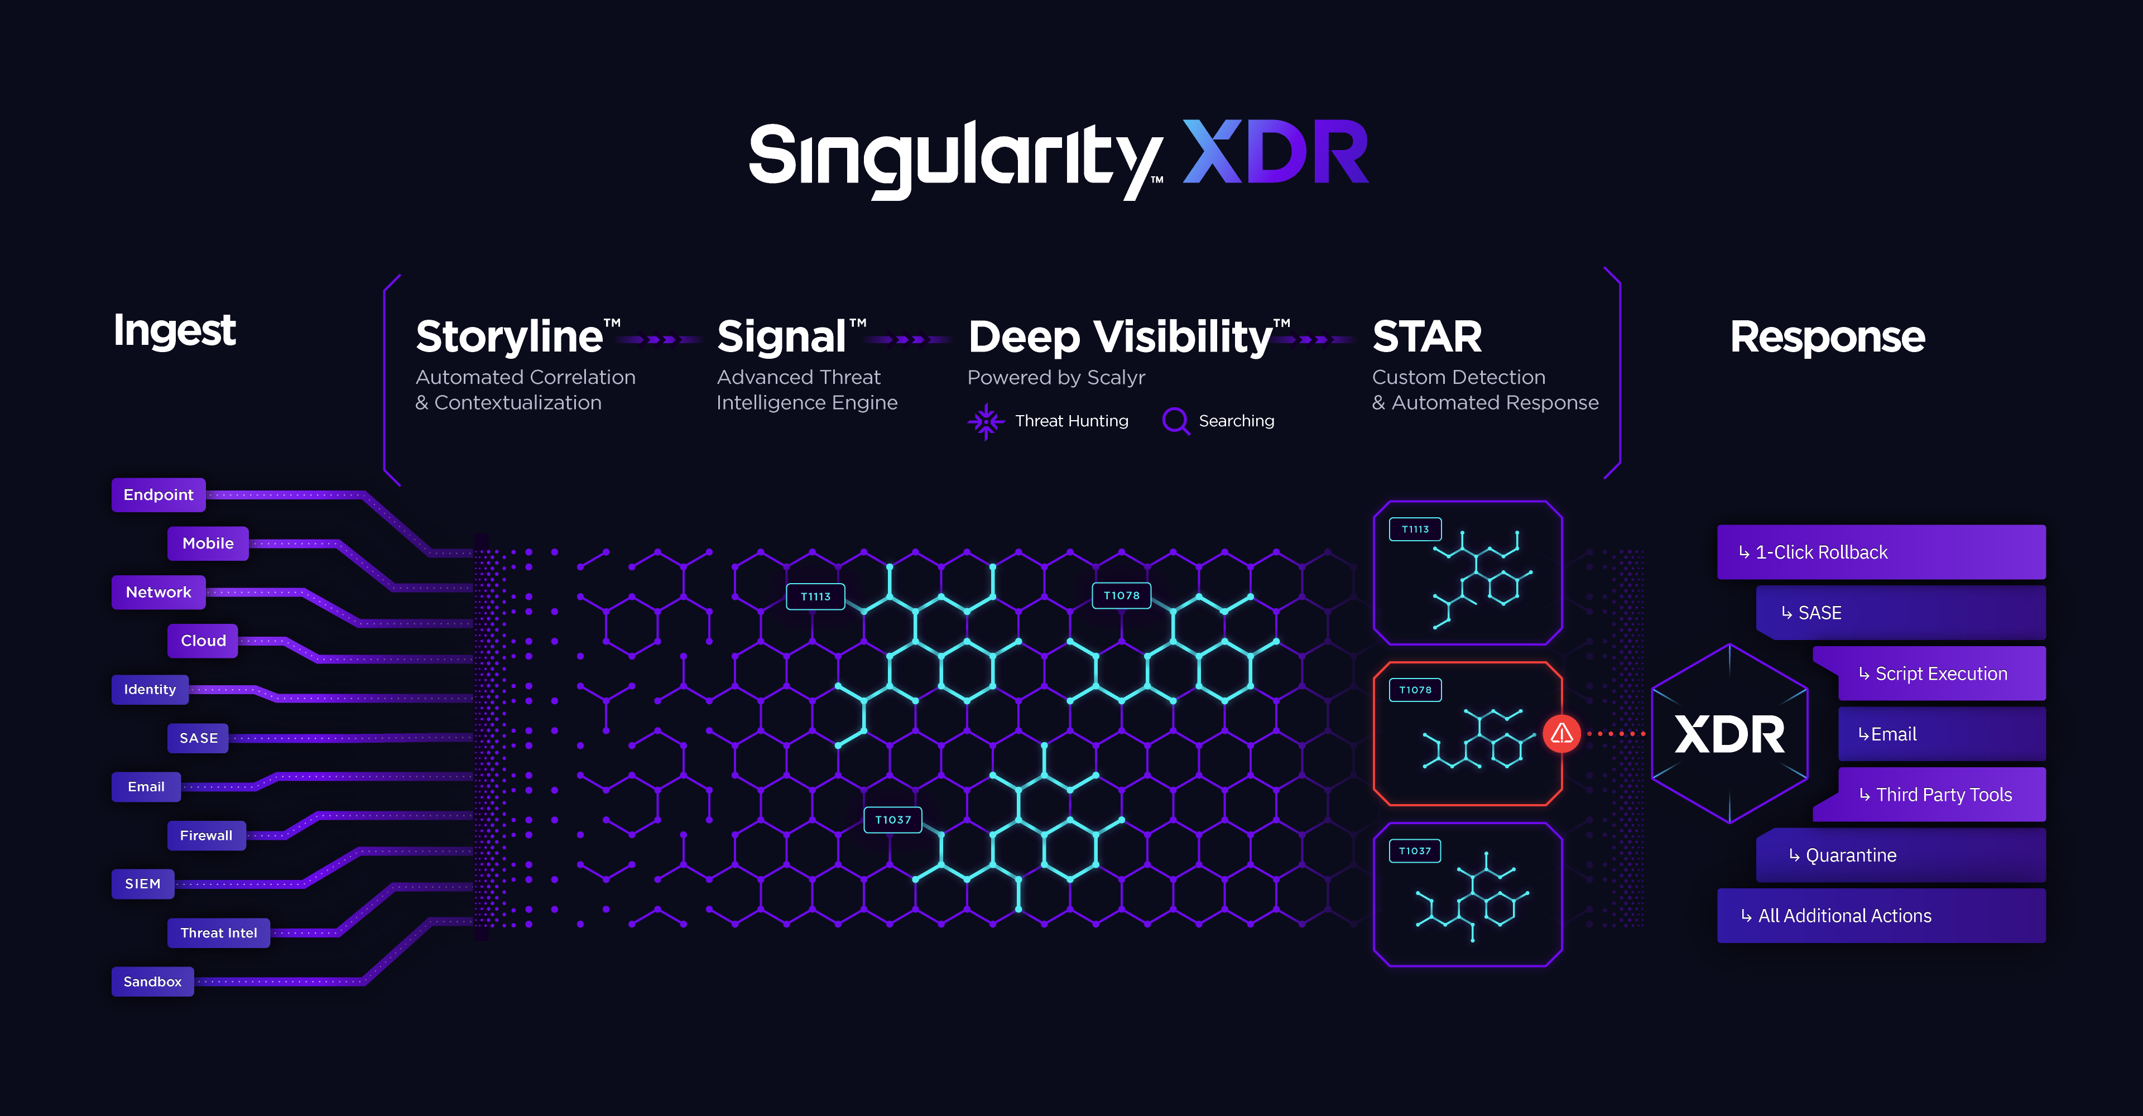
SentinelOne

Slide 17
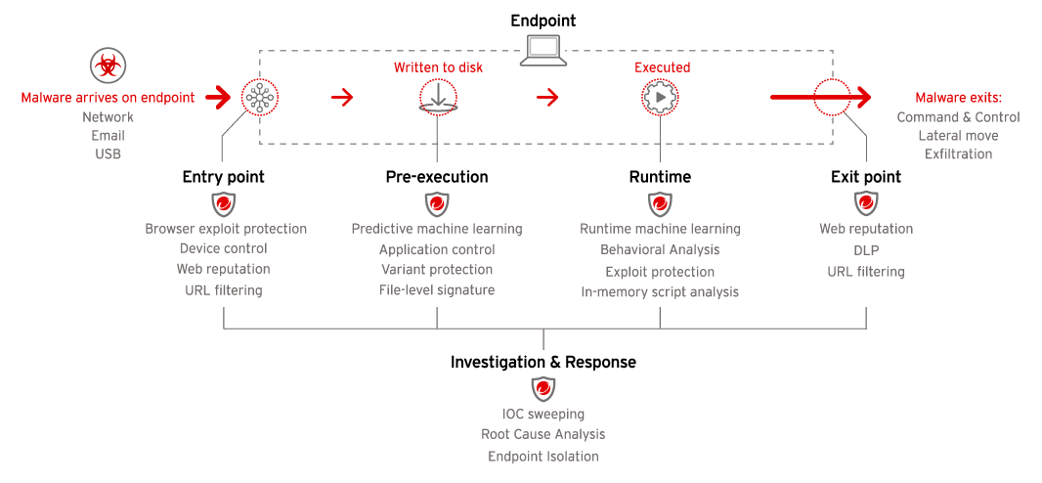
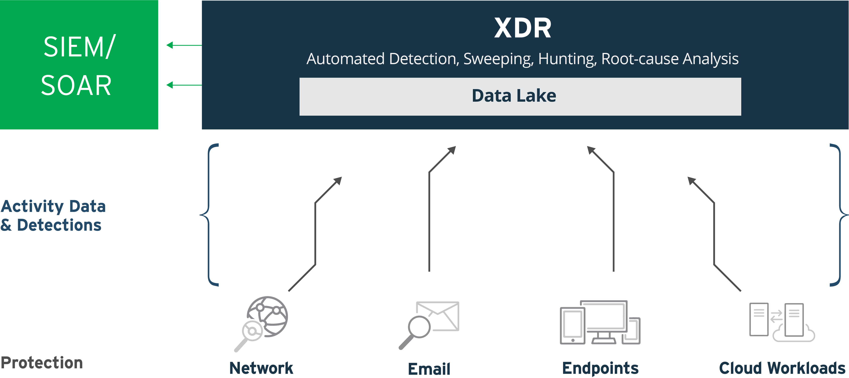
Trend Micro Apex One / Vision One(XDR)

Slide 18

XDR advantage against EDR
XDR platforms may streamline investigation
Identify threats proactively
Track threats across the organization
Increase productivity
Conclude investigations more efficiently
Reduce mean-time-to-detect (MTTD) and mean-time-to-respond (MTTR)
Improve detection and response capabilities
Lower the time and cost investment of other solutions

Slide 19

EDR, MDR, SIEM, XDR
Endpoint Detection and Response (EDR) is an endpoint security solution that continuously monitors end-user devices to detect and respond to cyber threats like ransomware and malware
Managed Detection and Response (MDR) refers to outsourced security activities for organizations that don’t have dedicated security teams. MDR combines analytics, threat intelligence, and human expertise to support businesses that are unable to do this in-house
Security Information and Event Management (SIEM) tools allow organizations to collect logs and alerts from multiple solutions
Extended Detection and Response (XDR) combines elements of EDR and MDR into a comprehensive solution to improve detection and response speed
XDR broadens detection capabilities/visibility by aggregating insights from various sources

